Slide 1
Introduction to Paper One
Aoife O’Driscoll
www.aoifesnotes.com

Slide 2
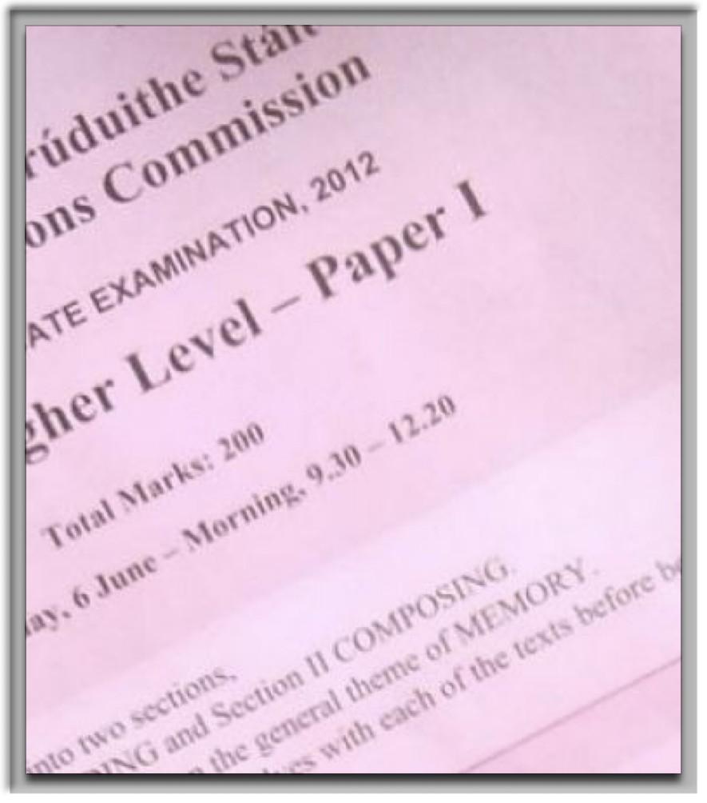

Layout
Both Paper One and Paper Two are worth 200 marks each, for a total of 400 marks for Leaving Cert English.
Be sure to spend equal time revising and preparing material for both papers.
You do not have to have every practice answer corrected: re-read them yourself with a critical eye.

Slide 3
Division of Marks and Time
Total time for Paper 1 - 2 hours and 50 minutes
Comprehension Question A - 50 marks - 45 minutes
Comprehension Question B - 50 marks - 45 minutes
Composition - 100 marks - 1 hour and 20 minutes

Slide 4

PCLM Marking Scheme
P= Clarity of Purpose
C= Coherence of Delivery
L = Efficiency of Language
M = Mechanics

Slide 5

Helpful video from Cian Hogan at the Institute of Education
Cian Hogan is a teacher at the Institute of Education and the author of Leaving Cert English poetry books. Here, he explains the PCLM marking scheme.
https://www.instituteofeducation.ie/studynotes/exam-times-supplement-3-english/

Slide 6

Theme - Each year the paper is based around a certain theme
2019 - Feeding Our Imaginations
2018 - Young Writers
2017 - Different Worlds
2016 - Journeys
2015 - Challenges
2014 - Influence
2013 - Story-telling
2012 - Memory
2011 - Mystery
2010 - The Future

Slide 7

2009 - Decisions
2008 - Identity
2007 - Change
2006 - Pretence
2005 - Ordinary Lives
2004 - Work and Play
2003 - Journeys
2002 - Family
2001 - Irishness

Slide 8
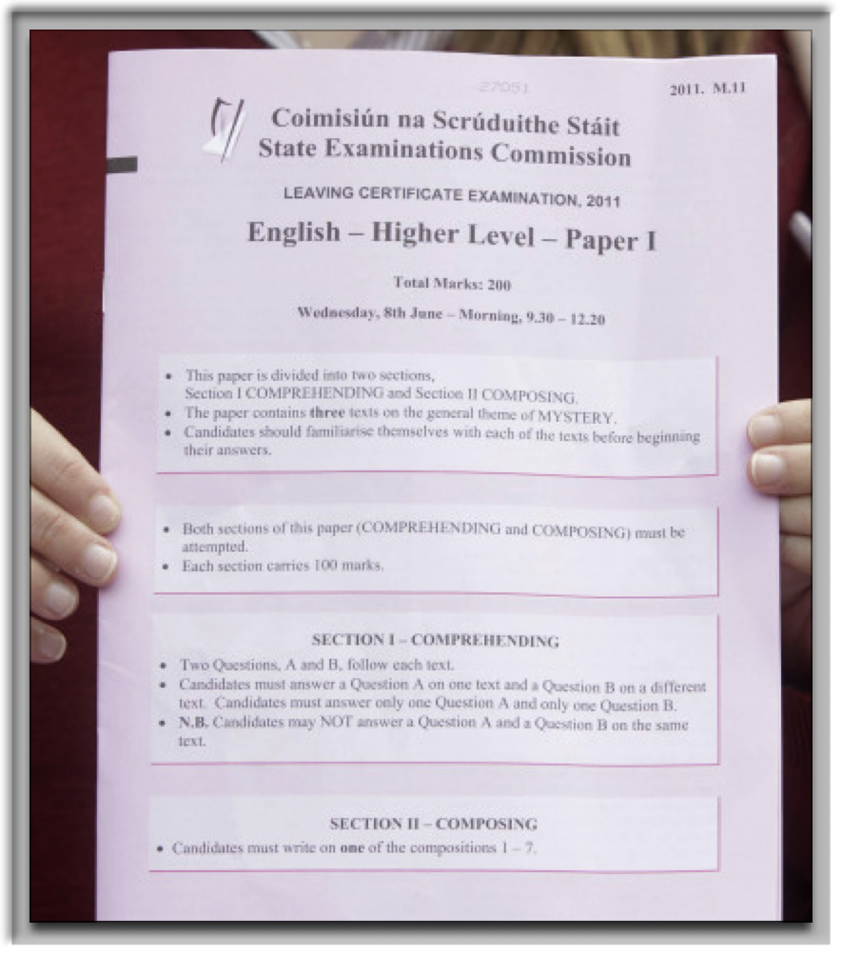
Approaching the Paper
Check the theme. It will be in capital letters on the front page of the exam booklet. The comprehensions will be based on this theme and the compositions will be based on the comprehensions.

Slide 9
Choose your Comp B task first as some tasks will suit you better than others. When you have selected this, cross out the Comp A answers so you do not answer them on that comprehension text.
When choosing which Comp A questions you will answer, consider the visual text and the style question. For example, you may like answering on the visual text or be more confident about answering a style question on discursive language rather than narrative language.
More detailed instructions on approaching Comp A and B questions can be found in other slideshows on this website.

